Slide 1
Passive Haptic Rehearsal for Accelerated Piano Skill Acquisition
Tan Gemicioglu, Noah Teuscher, Brahmi Dwivedi, Soobin Park, Emerson Miller, Celeste Mason, Caitlyn Seim, Thad Starner
Notes:
Hi! My name is Tan, I’m an undergraduate researcher at Georgia Tech and I’ll be presenting today about passive haptic rehearsal, a new approach to piano learning assisted by haptic feedback gloves.

Slide 2
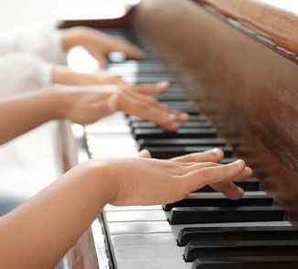
Motivation
Benefits to mental wellbeing and dexterity
Difficulties of learning piano later in life
Time constraints due to work
Active use of hands during day
Risk of repetitive strain injury
Notes:
Playing piano offers several benefits to mental wellbeing and dexterity. The idea for passive haptic rehearsal comes from the issues faced by a massage therapist, Fiona, who wants to learn and play piano in her own time but is prevented by constraints of time and risk of injury. Due to her busy workday and her child, Fiona can barely find time to practice piano. Similar limitations are often common for many people who learn or re-learn piano later in life. Moreover, as someone who already has to use her hands very often in the day, spending the rest of it practicing piano would put her at great risk of repetitive strain injury.

Slide 3
Passive Haptic Learning
2008 (Huang et al.): A single melody
2010 (Huang et al.): Melodic phrases, confirmation of passiveness
2015 (Seim et al.): Two hands, chorded songs
2021 (Donchev et al.): Benefits to retention
Now: Any piano piece
Notes:
To reduce such risks, passive haptic learning uses repeated vibrotactile stimulation to train users to play piano. Since this work started a decade ago, it has been expanded from a single melody to more complex phrases and eventually two-handed songs. More recently, a study found that passive haptic learning can offer greater retention of piano pieces in addition to a faster learning process. In this project, we expand the boundaries of passive haptic learning to generate lessons for any piano piece on the fly.

Slide 4
Augmented Piano Practice
Light-up keys
Extra visual indicators
Alternative displays of sheet music
Post-performance feedback
Gamification
Notes:
In parallel with passive haptic learning, HCI researchers have used various methods such as light-up keys and alternative visual displays to make the process of learning piano easier and faster. By giving better feedback and gamifying the process, they also helped keep users practicing consistently.

Slide 5
Passive Haptic Rehearsal Glove
Notes:
To make use of both of these trends, we propose passive haptic rehearsal instead of passive haptic learning. Whereas passive haptic learning was purely passive, rehearsal instead combines it with active practice. This makes the best use of passive haptic learning’s benefits to retention alongside the positive health benefits and feedback of active practice.
To facilitate this, we designed gloves that users could wear in their daily lives, so that they could do their passive rehearsal sessions at any time during the day.

Slide 6
Web Portal
Notes:
To interface with these gloves, we built our own web portal, which both controls our gloves for passive sessions and assists active practice sessions with feedback. For passive rehearsal, users can set up passive practice sessions of any length and select lessons to decide which part to rehearse. For active sessions, they can send the piece they’d like to play to the light-up keyboard to get a visual demonstration of the piece. They can also get feedback on their mistakes from a recording of their practice session and take notes on these after they’re done with their active practice.

Slide 7
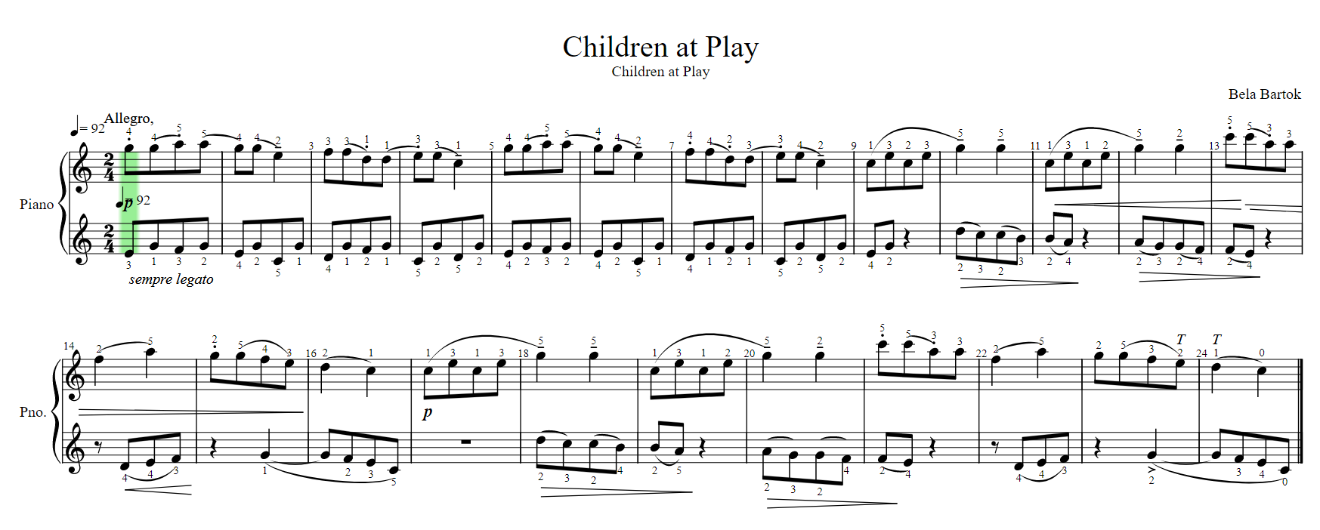
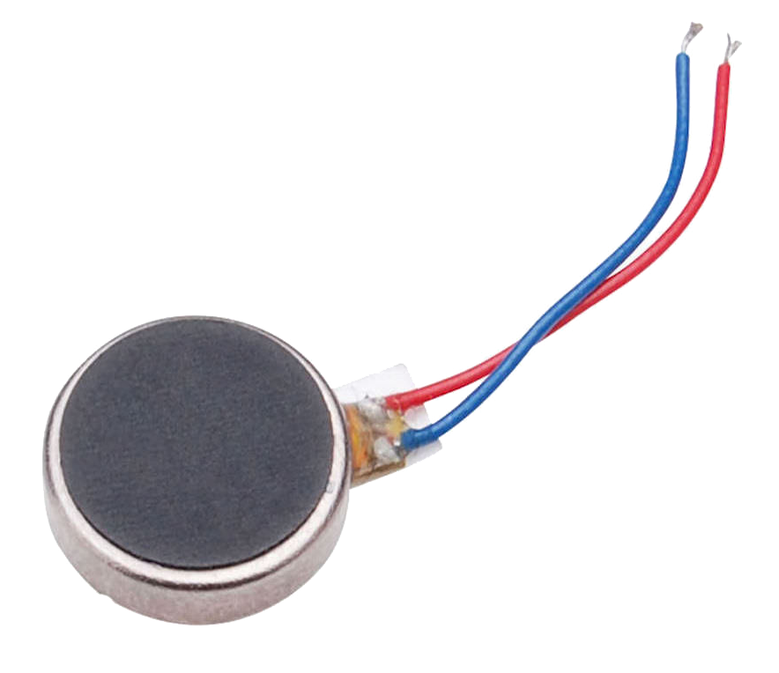
Sheet Music to Vibrotactile Stimulation
Notes:
The web portal can also take in any music XML file, a common digital format for sheet notes, generating fingerings that allow the piece to be played. These are then converted to smaller lessons of about 10 seconds and ordered sequences to command the motors on which finger should vibrate. The file is sent to the gloves over Bluetooth and stored there, allowing the user to practice when they wish.

Slide 8
Performance Evaluation
Needleman-Wunsch Algorithm
Notes:
Past work on passive haptic learning also used a simpler algorithm called dynamic time warping to evaluate performance. However, dynamic time warping has some shortcomings when it comes to piano, because it ignores when you repeatedly press the same key. Instead, we use the Needleman-Wunsch algorithm, an algorithm typically used in bioinformatics for aligning protein sequences. We also factor in issues with timing after the alignment to determine the user’s rhythmic accuracy.

Slide 9
Pilot Study
2 weeks, practicing every day
Half an hour of active practice
2.5 hours of passive stimulation
2 participants
Past musical history, but lack of practice
Not assisted by piano teachers
Notes:
Currently, we are running a pilot study to determine any shortcomings in our hardware and software design as well as study procedure. This study will run for 2 weeks, with the users practicing every day. This constitutes half an hour of active practice, and 2.5 hours of passive stimulation where they wear the gloves and keep it running. For the 2 participants of this first study, we aimed to have people with some past musical history as it’s necessary for reading sheet notes, but the user is not assisted by piano teachers. We plan to keep this design for our real-world study, while expanding it to be more rigorous for measuring the impact of passive haptic rehearsal.

Slide 10
Proposed Real-World Study
16 participants, paired by skill
2 conditions: sham gloves, functional haptic gloves
2 equivalent piano pieces
2x2 Latin square design for counterbalancing
Performance
evaluation on piece 1
2 weeks of practice for piece 1
Performance
evaluation on both
2 weeks of practice for piece 2
Performance
evaluation on piece 2
Group 1:
Group 2:
Performance
evaluation on piece 2
2 weeks of practice for piece 2
Performance
evaluation on both
2 weeks of practice for piece 1
Performance
evaluation on piece 1
*Both groups further split to sham and functional
Notes:
In our following study, we will be gathering 16 participants and pairing them up by their skill levels, as measured in an initial performance evaluation. Following a mixed-subjects design, they will then be assigned to one of 4 conditions, either using a sham glove or functional haptic glove and practicing one of 2 piano pieces we selected. These are counterbalanced by having them first practice on one piano piece and then the other, depending on which group they are assigned to, over the duration of one month. We’ll evaluate their performance at 3 points: at the start, after they are done with their first piece, and at the end of the study.

Slide 11
Conclusion
For usability, passive haptic rehearsal > passive haptic learning
Passive haptic rehearsal
Reduces the amount of time and practice necessary for learning piano
Can be combined with active practice for greater benefit
Assists self-paced piano learners
Is a feasible and useful application for passive haptic training in the real world
Notes:
In conclusion, we posit that for a technology usable in real life for piano practice, passive haptic rehearsal offers greater potential than passive haptic learning. Passive haptic rehearsal makes the process of learning piano easier and assists self-paced learners by reducing time constraints and risks of injury. Most importantly, it can be combined with active practice to get the benefits of playing piano, making the best use of learners’ time.

Slide 12
Future Work
Pedagogy: How should lessons be structured and repeated?
Design: How can the vibrations be optimized to increase learning while maintaining minimal attention requirements?
Music Education: How could the system complement traditional piano education with a teacher?
Neuroscience: What allows passive learning to happen?
Gamification: How can the process be gamified to encourage learning?
Notes:
Passive haptic rehearsal is still a very fresh idea, and there is potential future work in many directions. The lessons and patterns of vibrotactile stimulation we use are based on the limited few past studies of passive haptic learning, and there are many ways of structuring these to optimize learning. Moreover, there’s still many unanswered questions in the neural correlates of passive learning and great challenges it faces in becoming an emerging consumer technology.

Slide 13
Contributions
A passive haptic rehearsal glove usable in daily life
A user-friendly web portal to assist active and passive piano practice
A quantitative metric for measuring piano performance
Soon: A study investigating the potential of passive haptic rehearsal as a consumer technology
Questions?
Email: tgemici@gatech.edu
Paper: https://arxiv.org/abs/2203.12749
Thanks to
Notes:
I’d like to thank the Georgia Research Alliance and NSF for the financial support that made this project possible. I’d also like to thank the workshop organizers for this opportunity. Now, I’ll be taking any questions you may have.

